Slide 1

Exam AI-900: Microsoft Azure AI Fundamentals
Tim Warner

Slide 2
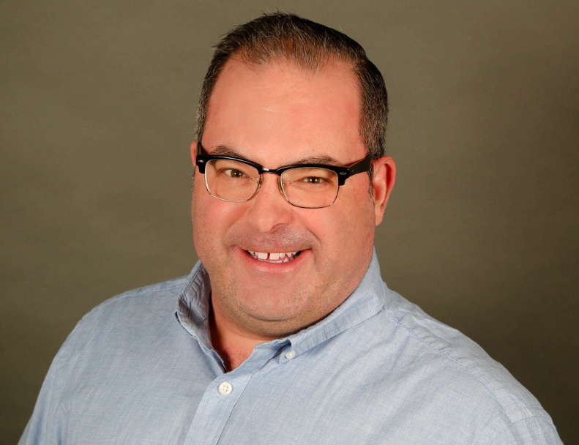

Tim Warner
Nashville, TN, US
Microsoft Certified Trainer (MCT)
MVP (Cloud & Datacenter Management)
Twitter: @TechTrainerTim
Badges: timw.info

Slide 3
Session 1 of 2 Learning Goals
Introduction
Describe Artificial Intelligence (AI) Workloads
Review Responsible AI
Describe Machine Learning
Work with Computer Vision Workloads

Slide 4
Session 2 of 2 Learning Goals
Work with Natural Language Processing (NLP) Workloads
Work with Conversational AI Workloads
Develop an AI-900 Exam Strategy

Slide 5
Course Materials
timw.info/ai900

Slide 6
Expectations
This is a "crash course"
Plan to review these materials more than once
Five-minute break at midpoint
Please ask/answer questions and provide feedback in the Q/A panel, not the group chat

Slide 7

Course Recordings

Slide 8

Course Recordings

Slide 9
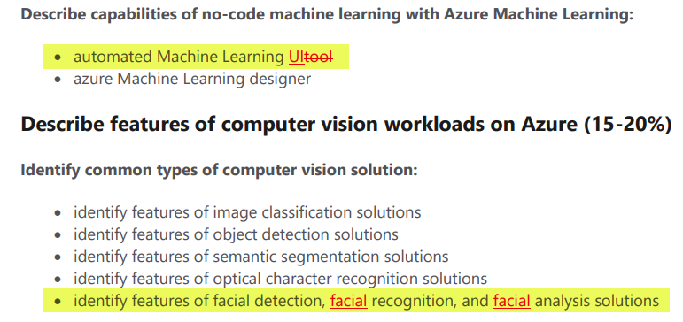
2020 Exam Update Information
Microsoft Worldwide Learning (WWL) revisits the Azure role-based certs yearly
AI-900 updates on October 22, 2020
The updates are trivial and cosmetic

Slide 10
Tim's Certification Study Pyramid
Interdependence
Content knowledge
Practical application
Test-taking skills

Slide 11
Fundamental Terminology

Slide 12
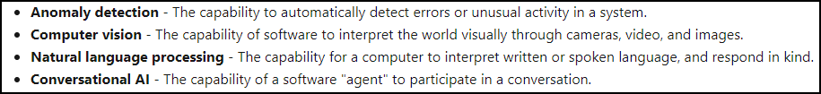
Artificial Intelligence (AI)
Any technique that enables computers to mimic human intelligence
https://timw.info/2bdb4

Slide 13
Machine Learning (ML)
Subset of AI that includes techniques that enable machines to improve at tasks with experience
The system "learns" without being explicitly programmed to do so
Supervised
Unsupervised

Slide 14
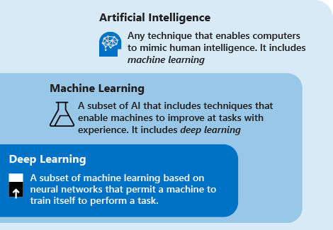
AI Schema
https://timw.info/c7769

Slide 15
Azure AI Technology Stack Overview

Slide 16
Azure AI Stack
Apache Spark on Azure (MMLSpark)
HDInsight
Databricks
Azure Machine Learning
Azure Cognitive Services
Azure Cognitive Search
Azure Bot Service

Slide 17
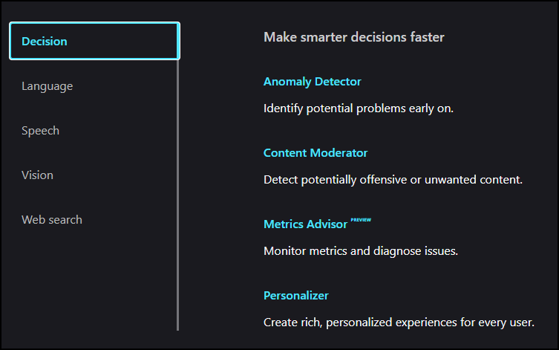
Azure Cognitive Services
Prediction
https://timw.info/b3f9f

Slide 18
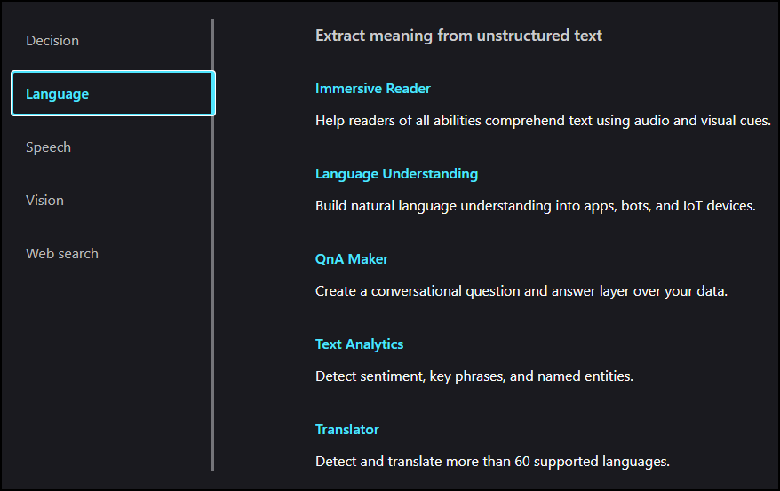
Azure Cognitive Services
Natural Language Processing (NLP)
https://timw.info/b3f9f

Slide 19
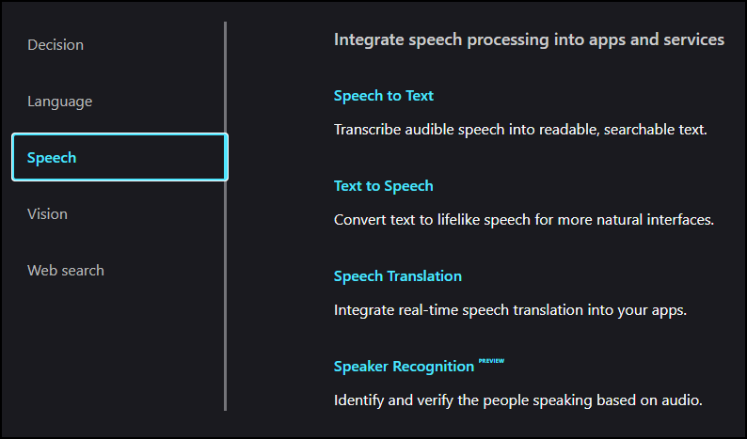
Azure Cognitive Services
Conversational AI
https://timw.info/b3f9f

Slide 20
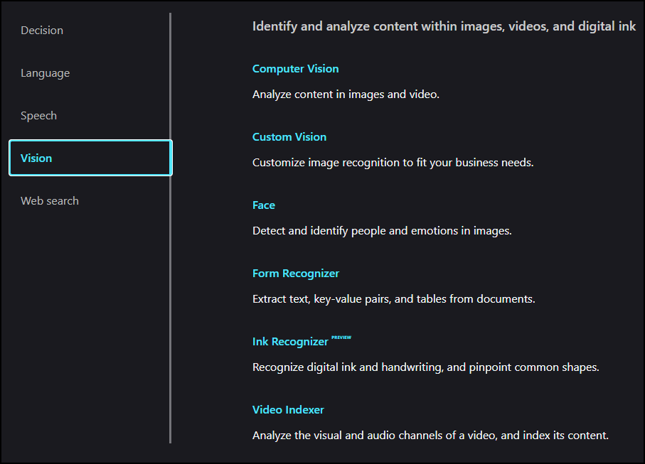
Azure Cognitive Services
https://timw.info/b3f9f

Slide 21
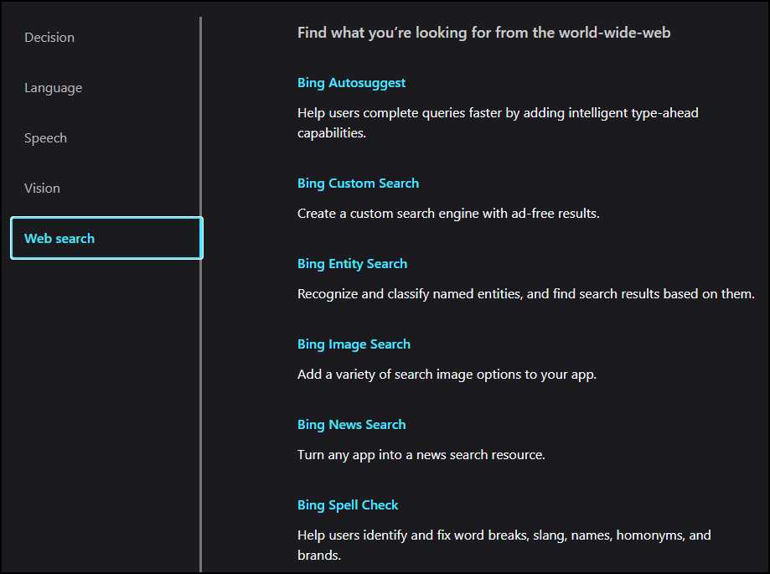
Azure Cognitive Services
https://timw.info/b3f9f

Slide 22
Use Cases

Slide 23
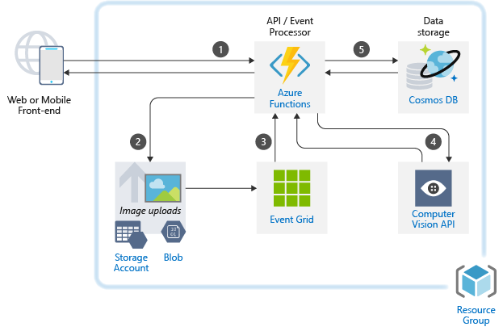
Image Classification
https://timw.info/caa25

Slide 24
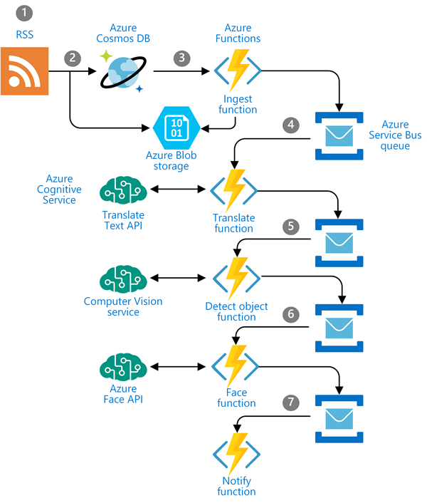
Newsfeed Ingestion
https://timw.info/c0015

Slide 25
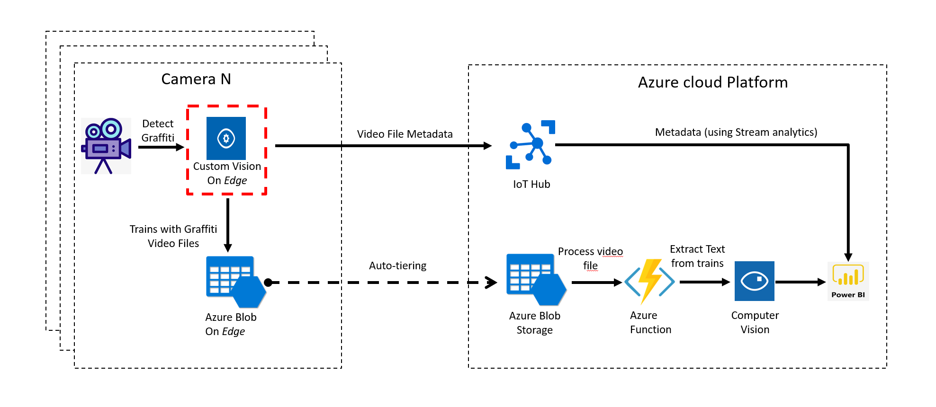
Internet of Things (IoT)
https://timw.info/3f2c0

Slide 26
Responsible AI

Slide 27
Microsoft's Position on AI Use
"We are committed to the advancement of AI driven by ethical principles that put people first."
Reference: https://timw.info/01bdb

Slide 28
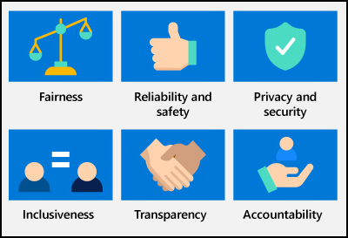
Responsible AI Principles
AI systems should treat all people fairly
AI systems should perform reliably and safely
AI systems should be secure and respect privacy
AI systems should empower everyone and engage people
AI systems should be understandable
Examples: https://timw.info/rai
People should be accountable for AI systems
https://timw.info/880e4

Slide 29
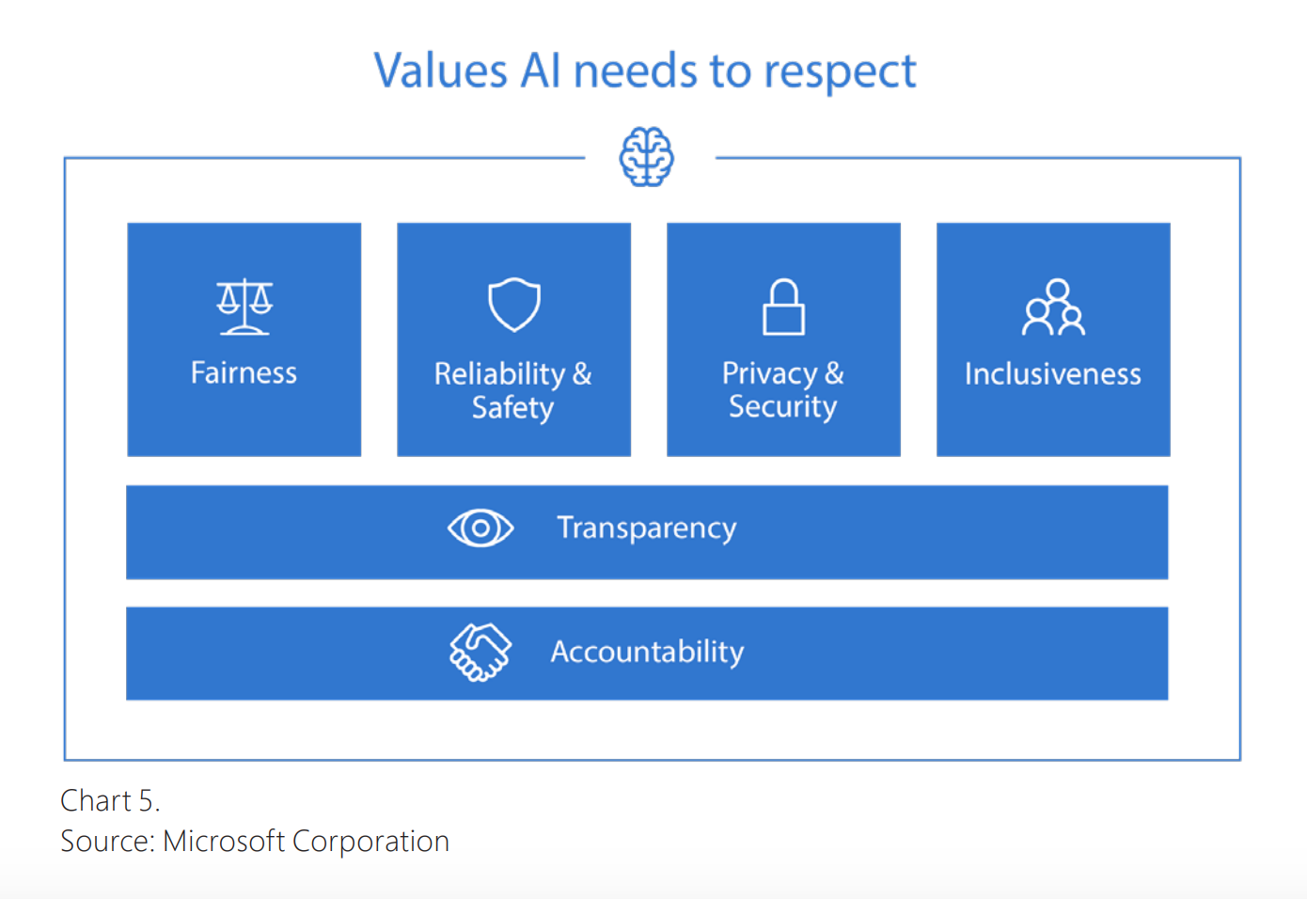

Responsible AI
Compliance Manager
https://timw.info/84db2

Slide 30
Azure Machine Learning

Slide 31
Machine Learning (ML)
Subset of AI that includes techniques that enable machines to improve at tasks with experience
Supervised
Regression: Predicting numeric data
Classification: Organizing non-numeric, discrete data
Unsupervised
Clustering
Pattern recognition

Slide 32
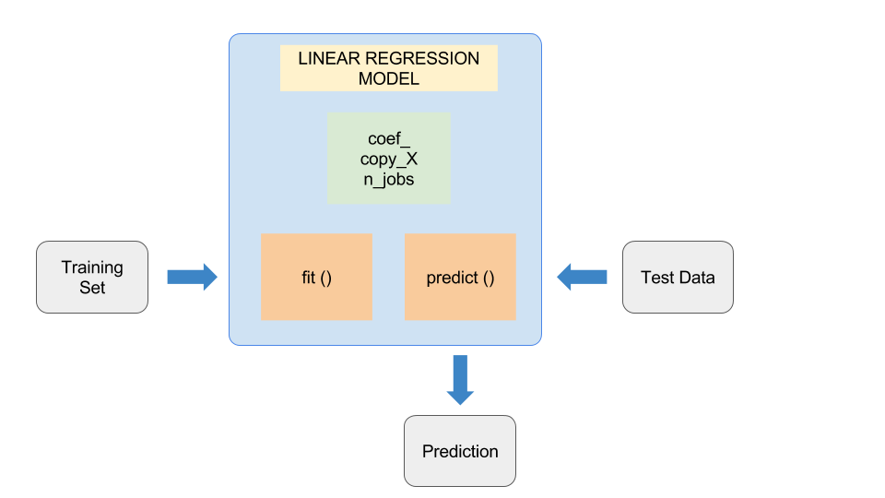
ML Model
Feature (Descriptive attribute) engineering vs. feature selection
Label: What you're trying to forecast
https://timw.info/37a04

Slide 33
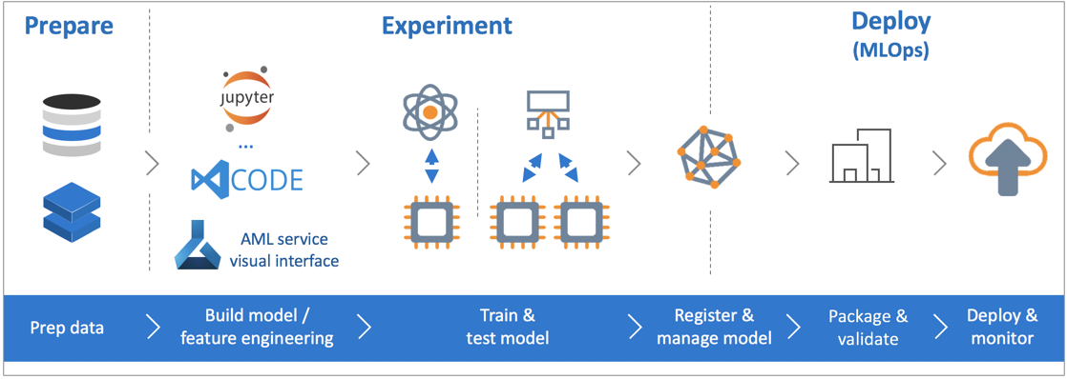
Azure Machine Learning Service
https://timw.info/de625

Slide 34
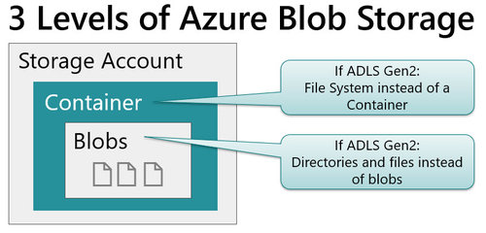
Blob Storage and Data Lake Storage
CSV, JSON
https://timw.info/772f8

Slide 35
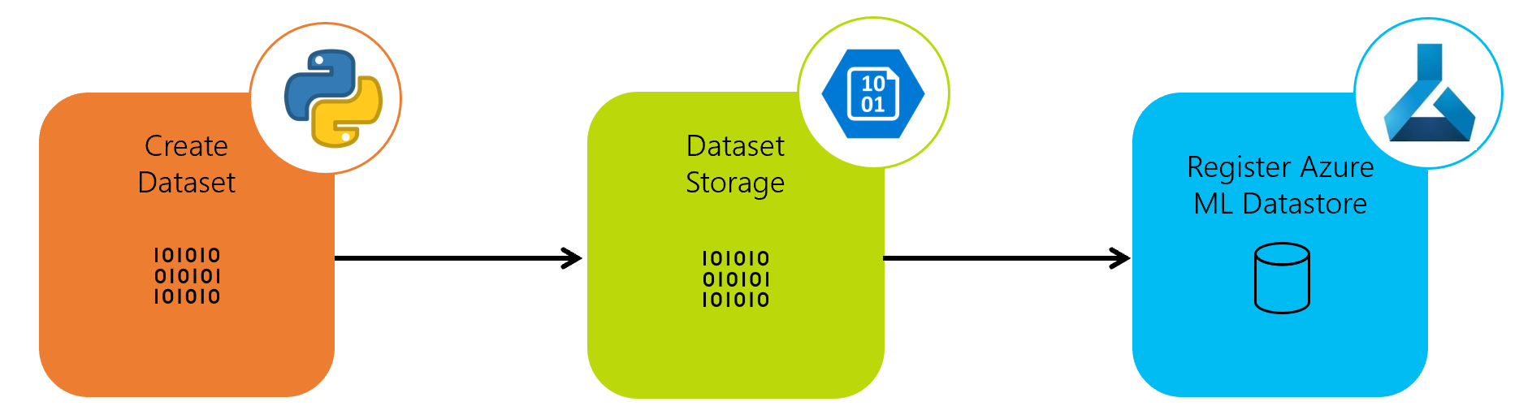
Azure ML Dataset & Datastore
A reference to your dataset in Azure storage
Authenticated context
https://timw.info/a1df2

Slide 36
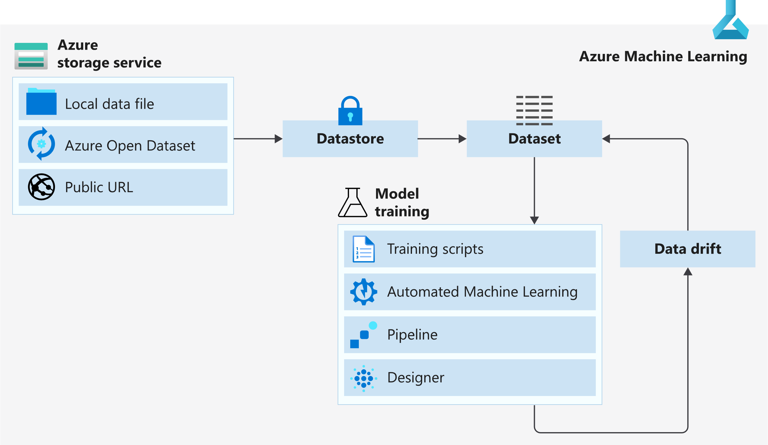
Azure ML Dataset & Datastore
https://timw.info/5a306

Slide 37
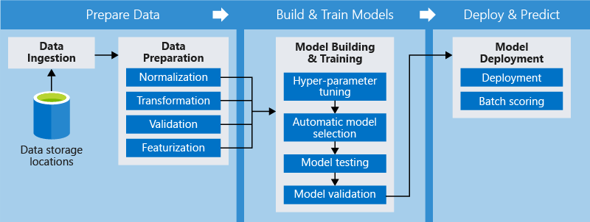
Azure ML Pipeline
https://timw.info/d572e

Slide 38
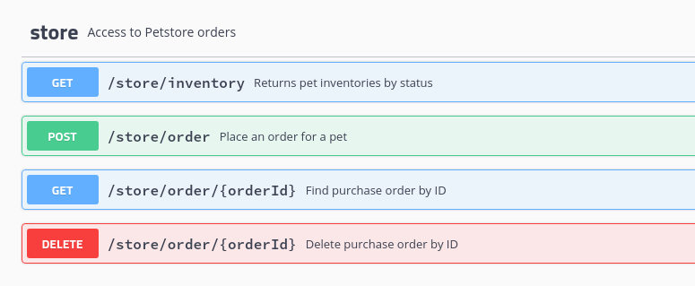
HTTP Methods
https://timw.info/cc6b1

Slide 39
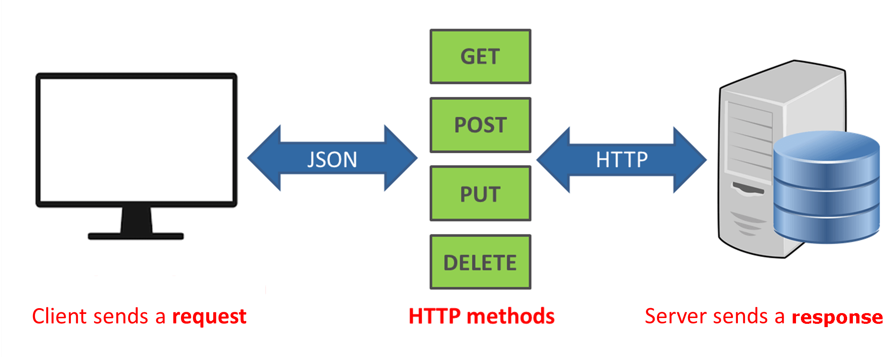
How a REST API Works
CRUD
https://timw.info/a850d

Slide 40

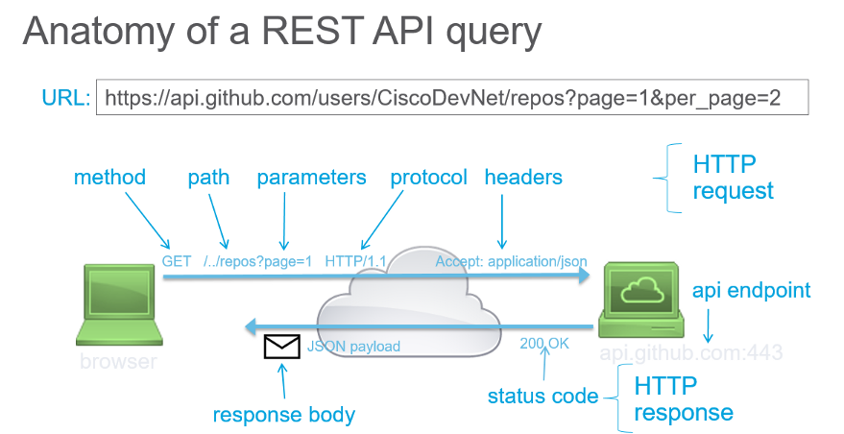
How a REST API Works
https://timw.info/d7a91

Slide 41
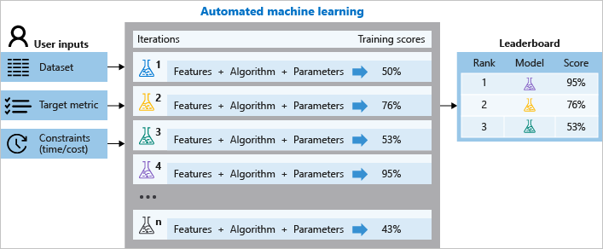
Azure Automated ML
Build ML models in a much more efficient manner
https://timw.info/aai3

Slide 42
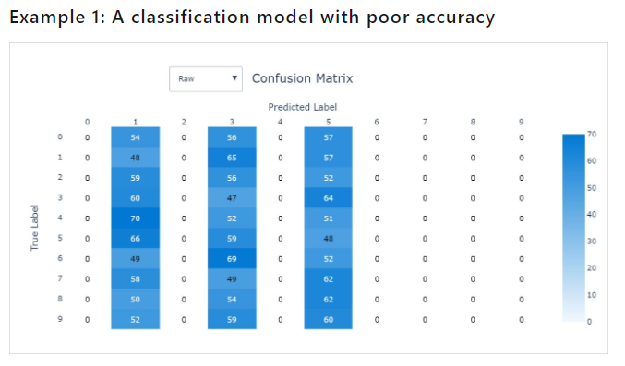
Validating AutoML Models
Confusion matrix
https://timw.info/26d20

Slide 43
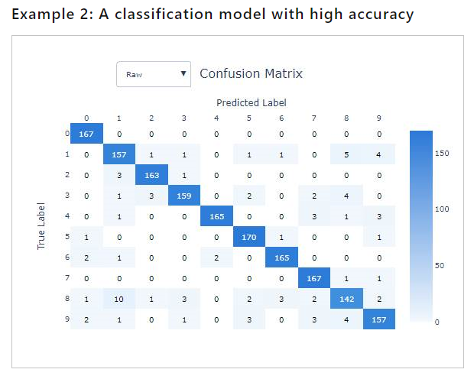
Validating AutoML Models
Confusion matrix
https://timw.info/26d20

Slide 44
Computer Vision

Slide 45
Computer Vision Capabilities
Detect objects in images
Optical Character Recognition
Apply content tags to images
Detect faces in images

Slide 46
Software Development Kits (SDKs)
.NET
Python
Java
Node
Go

Slide 47
Exam AI-900 Strategy

Slide 48
Tim's Certification Study Pyramid
Interdependence
Content knowledge
Practical application
Test-taking skills

Slide 49
Item Types

Slide 50

Single Answer Multiple Choice

Slide 51

Multiple Answer Multiple Choice

Slide 52
Repeated Scenario
You need to move an Azure VM to another hardware host.
Solution: You redeploy the VM.
Does this solution meet the goal?
Yes
No

Slide 53
Repeated Scenario
You need to move an Azure VM to another hardware host.
Solution: You enable boot diagnostics.
Does this solution meet the goal?
Yes
No

Slide 54

Select and Place

Slide 55

Build List and Reorder

Slide 56

Active Screen/Fill in the Blank

Slide 57

Case Study

Slide 58






Performance-Based Lab

Slide 59
Microsoft Online Testing

Slide 60
Tim's Online Testing Video (YouTube)
timw.info/online

Slide 61

Microsoft Online Testing Process

Slide 62

Microsoft Online Testing Process

Slide 63

Microsoft Online Testing Process

Slide 64

Microsoft Online Testing Process

Slide 65

Microsoft Online Testing Process

Slide 66

Microsoft Online Testing Process

Slide 67

Microsoft Online Testing Process

Slide 68
Thank you!
Course materials: timw.info/ai900
Twitter: @TechTrainerTim
Courses: timw.info/ps
Web: TechTrainerTim.com

Slide 69
Azure Cognitive Services

Slide 70
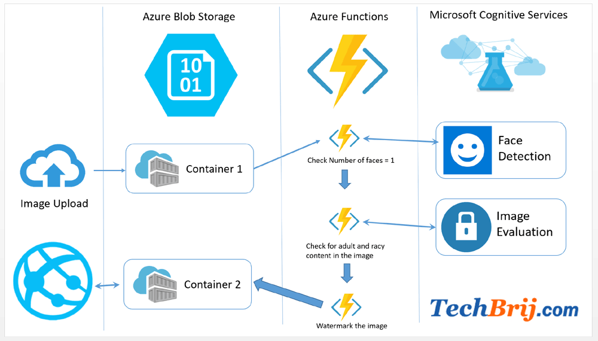

First Things First
Cognitive Services multi-service account
Azure Functions
https://timw.info/89e3b

Slide 71
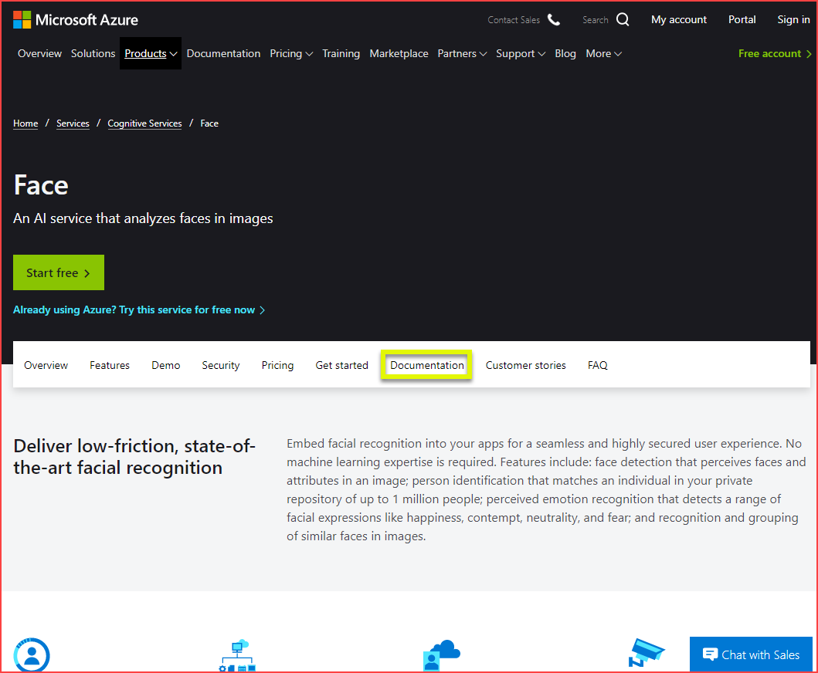
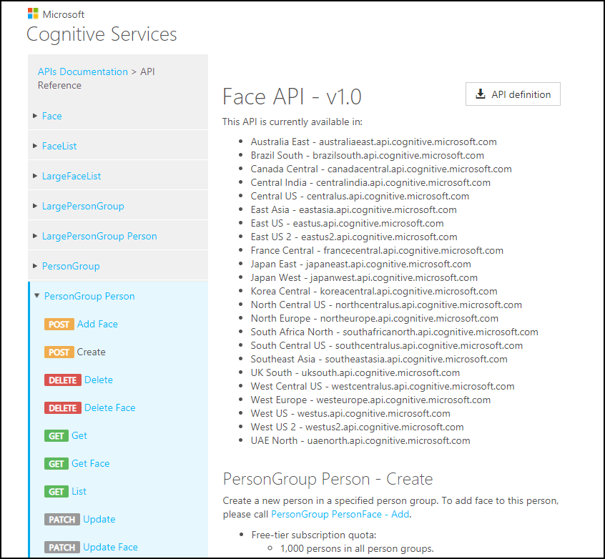
How To Know Cognitive Services

Slide 72
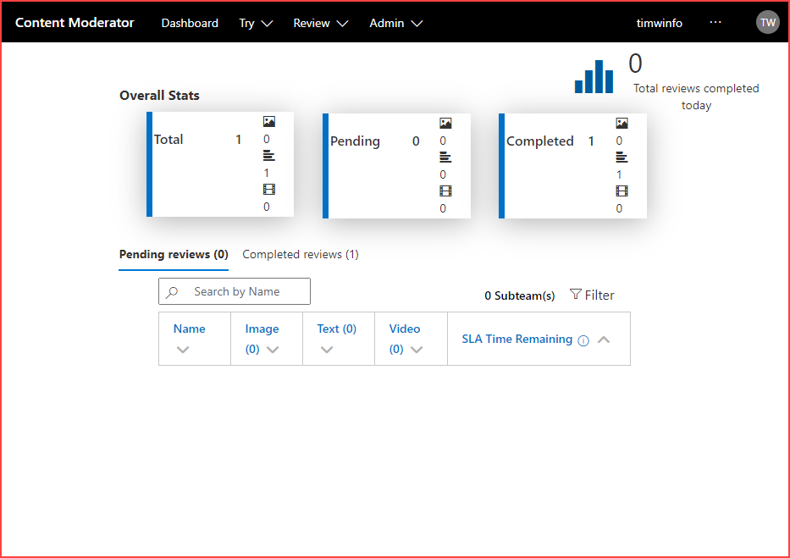
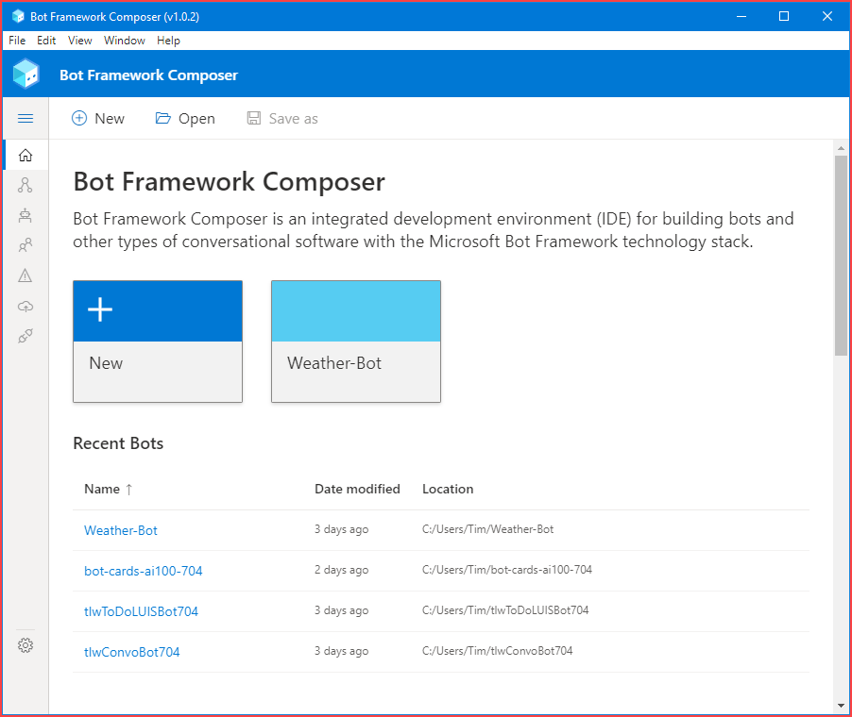
How To Know Cognitive Services

Slide 73
Computer Vision
Digital Asset Management (DAM) solution for image data
Detect objects and features
Detect corporate brands/logos
Describe an image
Optical character recognition (OCR)
Generate thumbnail
https://timw.info/bb965

Slide 74
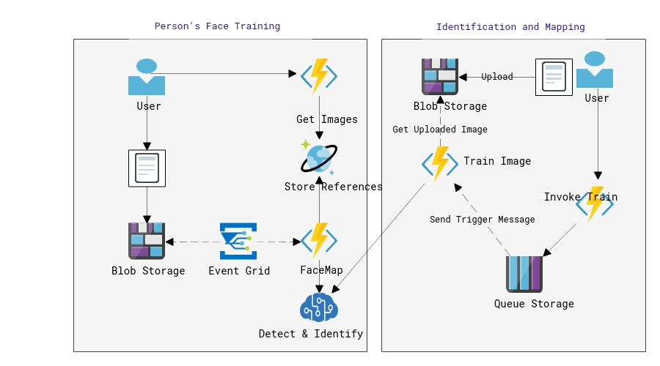
Face
Facial recognition
Facial verification
Emotion recognition
Person Group containers:
Person Group (10,000 persons)
Large Person Group (1M persons)
https://timw.info/31118

Slide 75
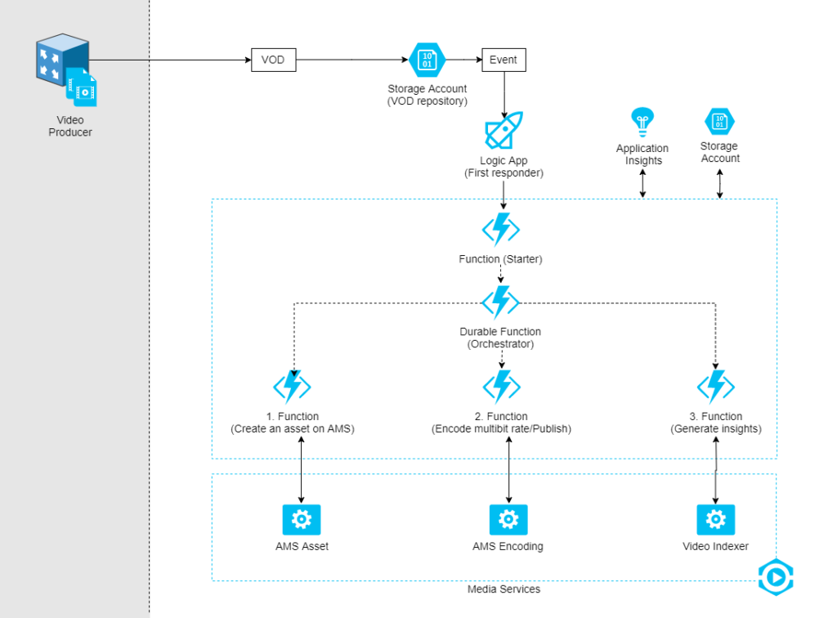
Video Indexer
Extract meaning from video and audio files
Index faces and spoken words
Great for making content available to vision- or hearing-challenged users
Content moderation
Azure Media Services
Encoding
https://timw.info/d0b4b

Slide 76
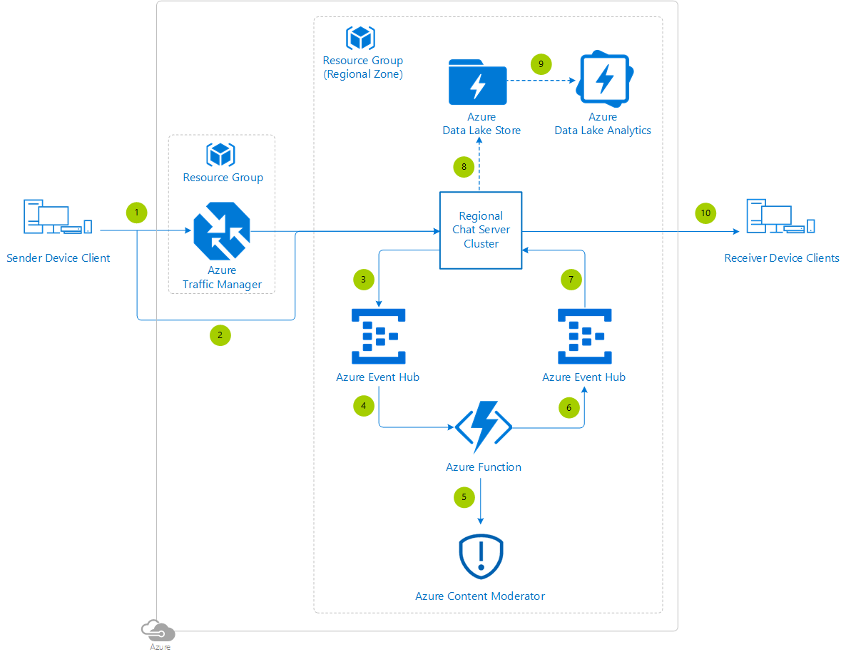
Content Moderator
Checks text, image, and video content for potentially undesirable content
Profanity
Adult or "racy" content
https://timw.info/7eec2

Slide 77
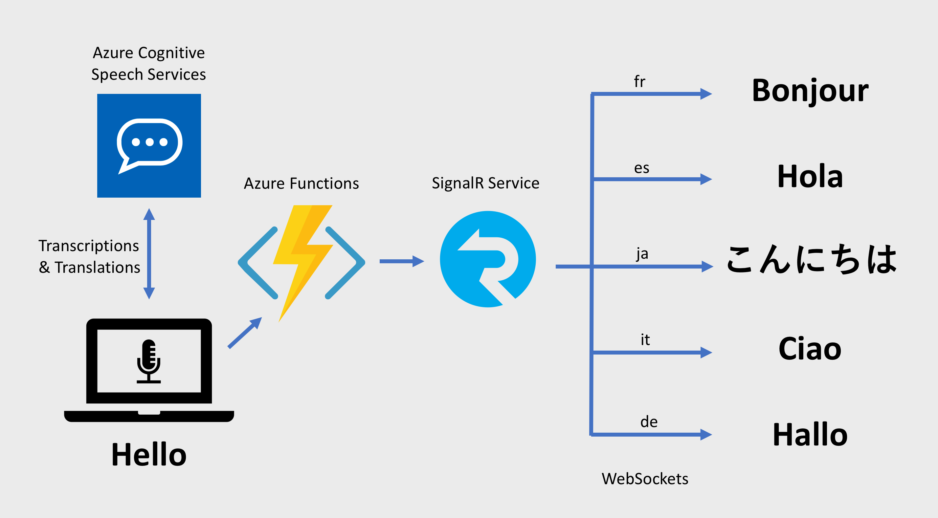
Speech
Speech-to-text: Transcribe audio from >40 languages
Speaker recognition:
Voice signature
https://timw.info/18876

Slide 78
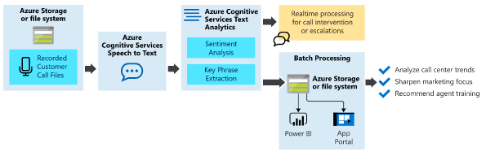
Text Analytics
Language detection
Sentiment analysis
Entity extraction
People
Places
Organizations
Objects
Translator: 60 languages
https://timw.info/87290

Slide 79
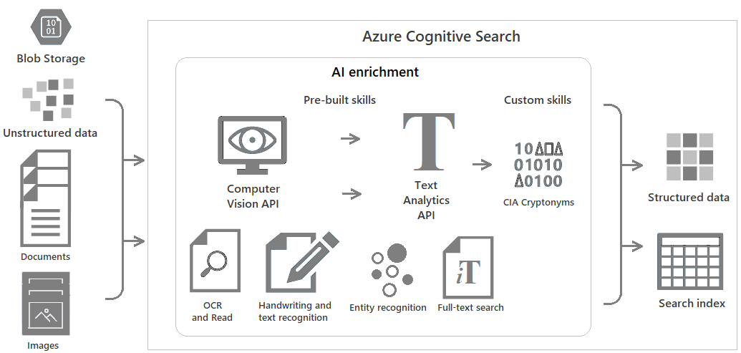
Azure Cognitive Search
https://timw.info/c6ab1

Slide 80
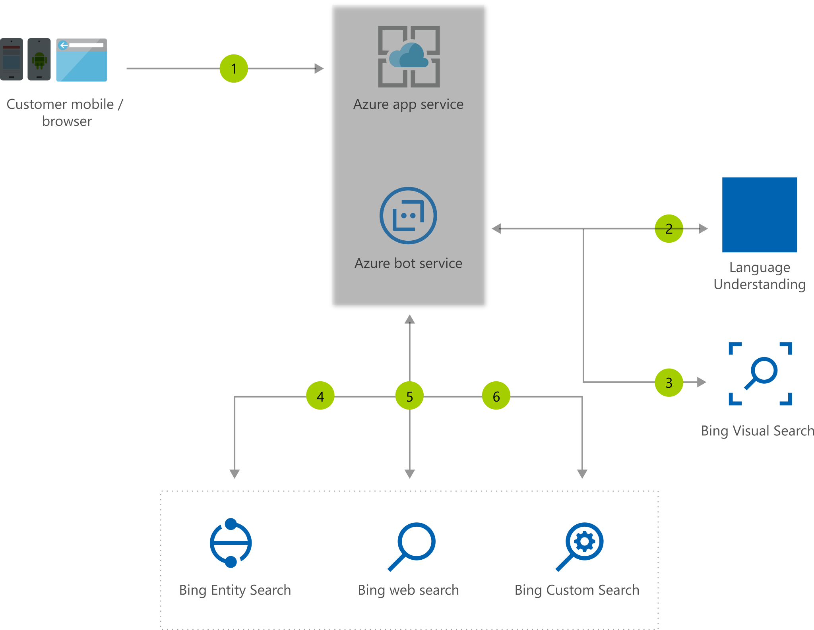
Bing Web Search
Retrieve answers from Bing search engine
Web pages
Images
Videos
News
https://timw.info/7640a

Slide 81
Azure Bot Service

Slide 82

What is a Bot?
Chatbot
Computer programmed designed to mimic human interaction
Turn based text/audio conversation
Alternative UI
Language Understanding Intelligent Service (LUIS)
Cortana

Slide 83
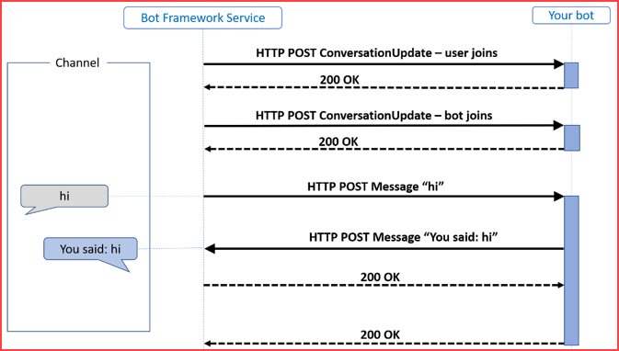
Azure Bot Service
Toolset to develop "intelligent agents"
Graphical:
Bot Framework Composer
Code:
Bot Framework SDK
C#, Python, JavaScript, Java
https://timw.info/87290

Slide 84
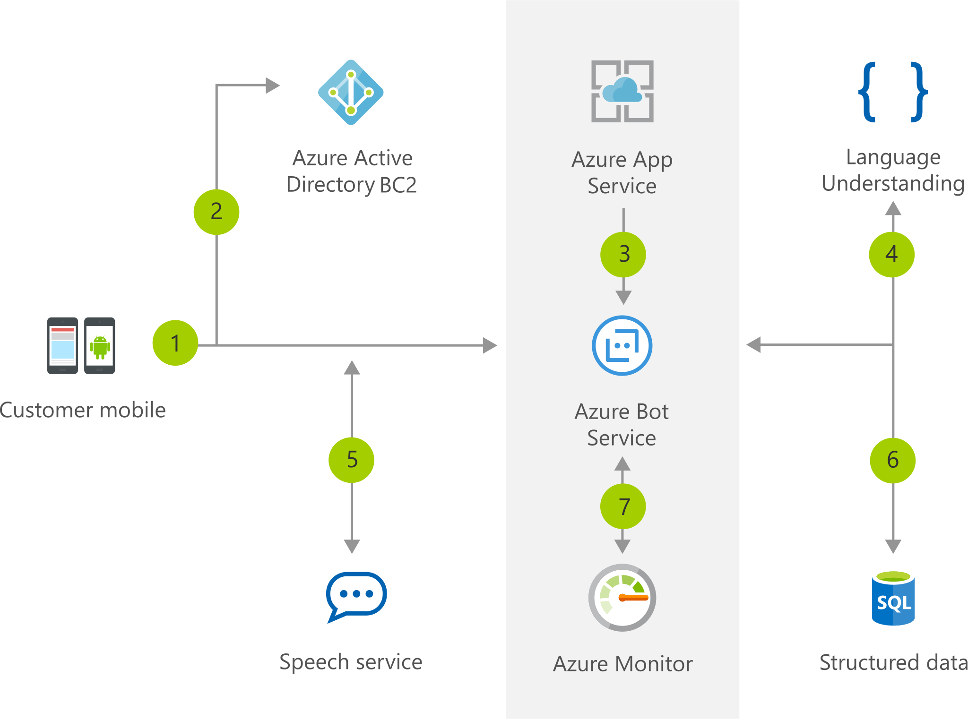
Chatbot
https://timw.info/b04eb

Slide 85
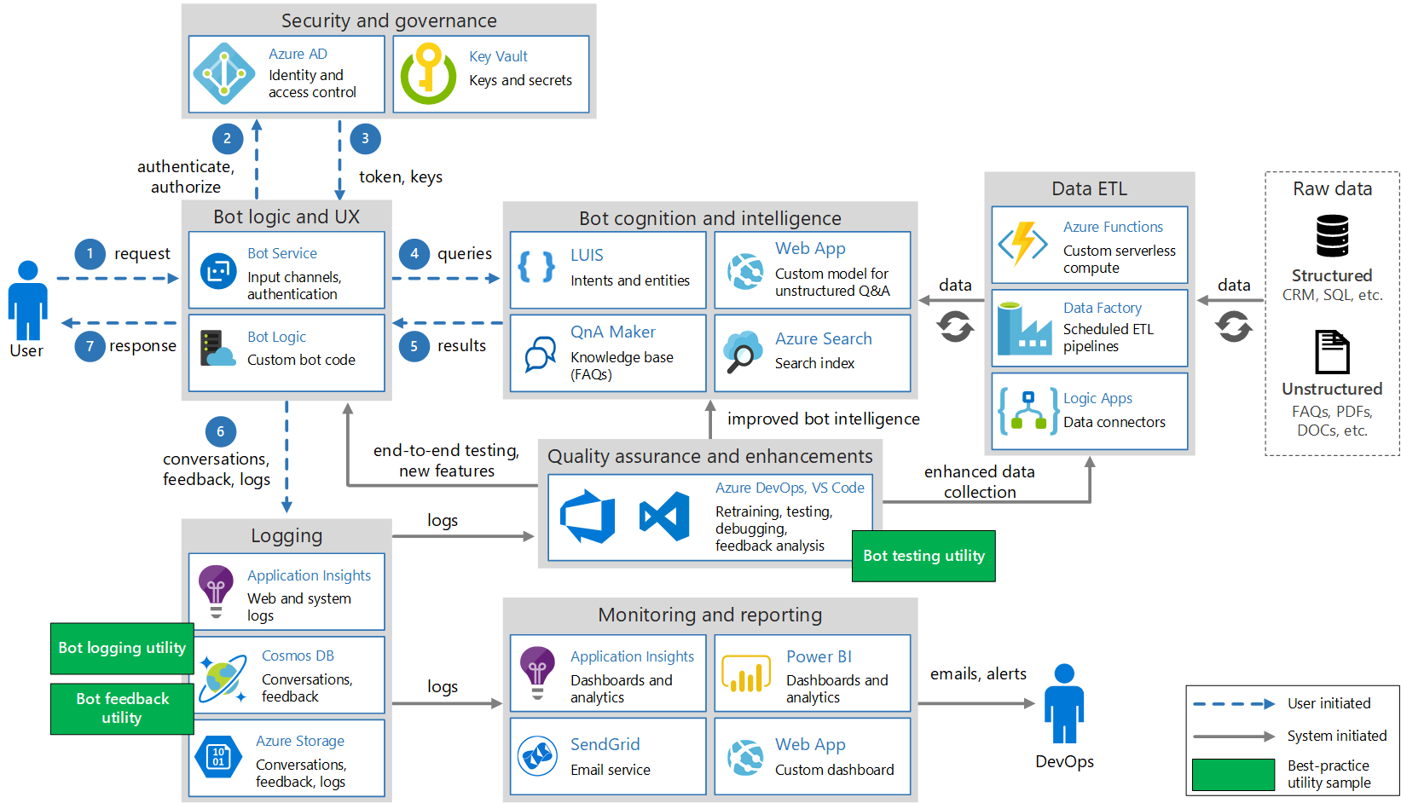
Conversational Bot
https://timw.info/32e9e

Slide 86
Monitoring

Slide 87

Azure Monitoring
https://timw.info/azmon

